Slide 1
Zotikon
Athlete Analysis System

Slide 2

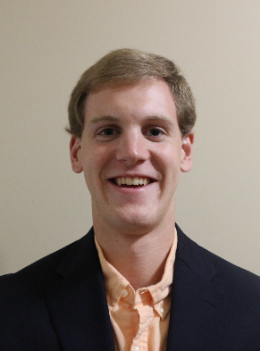



The Zotikon Team
Bruce Bowlin
Eric Farmer
Joseph Hastings
Van Kingma
Curtis Prehn

Slide 3
Zotikon’s Advisor
Dr. Mehmet Kurum
Assistant Professor
PhD, Electrical and Computer Engineering, George Washington University, 2009
Fields of Interest
Microwave and Millimeter-wave Remote Sensing
RF Sensors & Systems
Radiation and Scattering Theory
Antennas & Computational Electromagnetics
Subsurface & Subcanopy Sensing and Imaging
GNSS Reflectometry

Slide 4
Outline
Problem Statement
Design Constraints
Progress
Approach
System Overview
Timeline

Slide 5
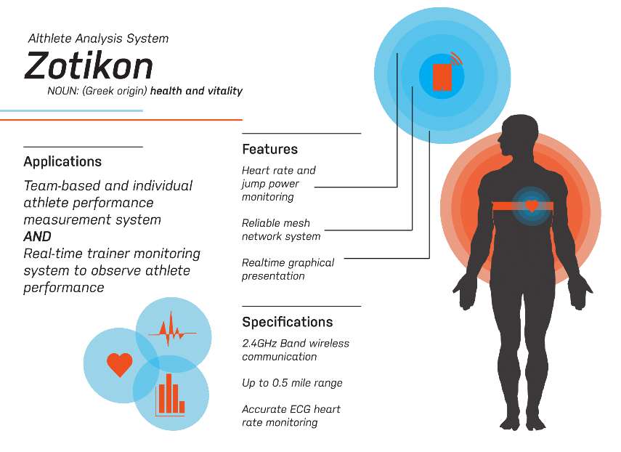

Slide 6
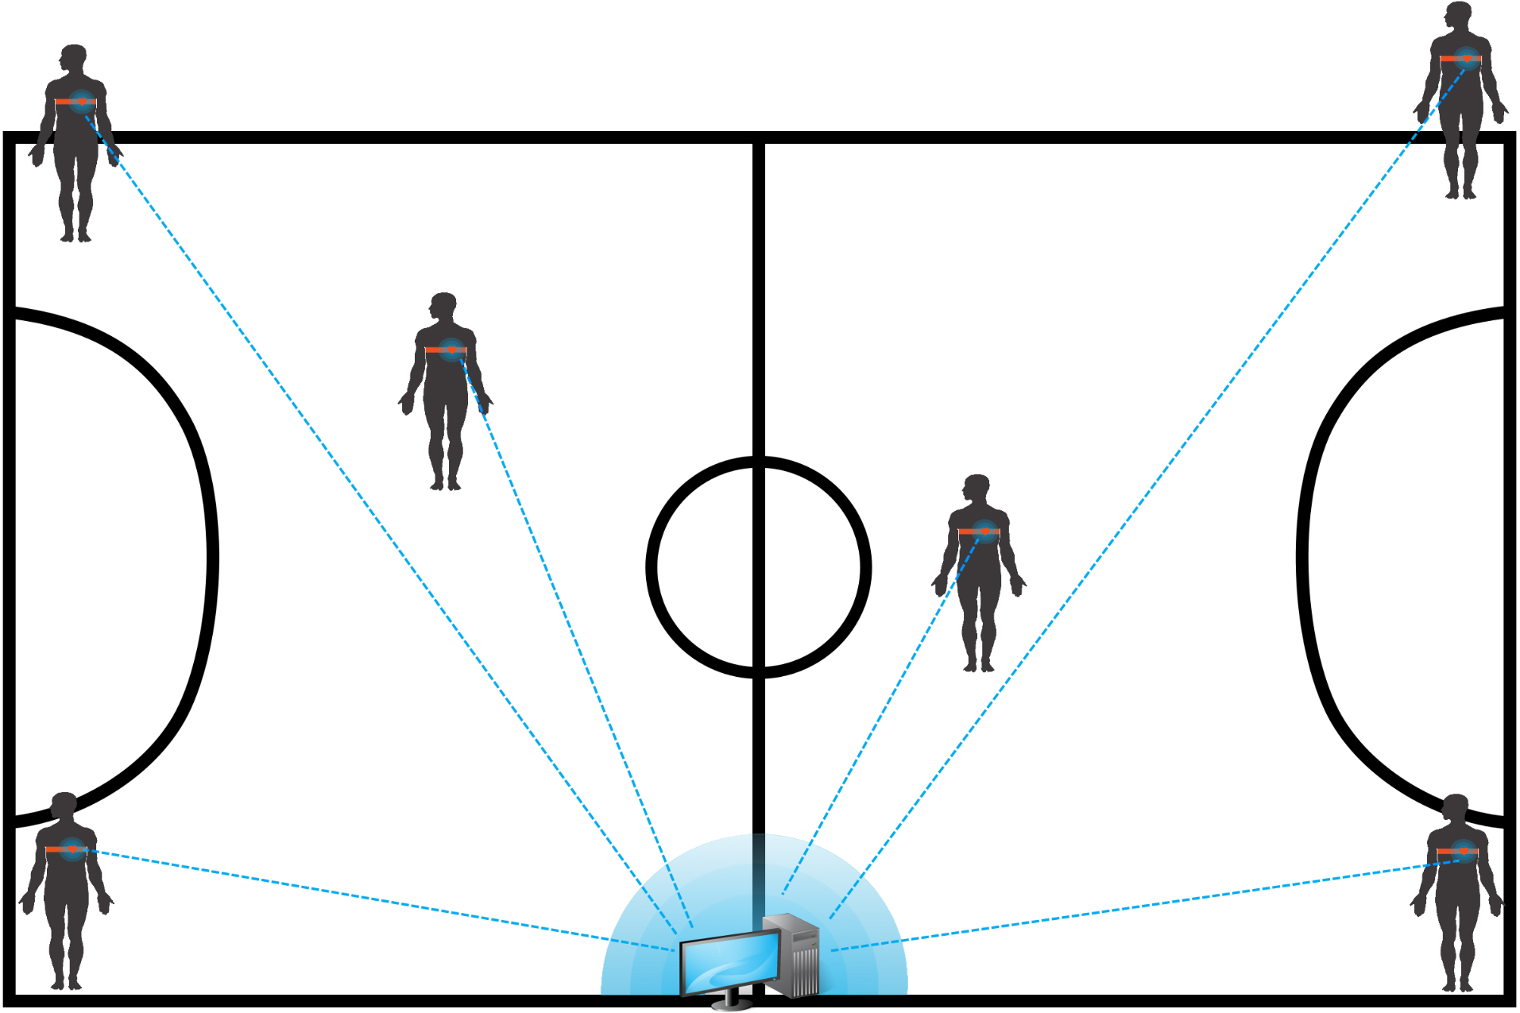
Problem Statement

Slide 7
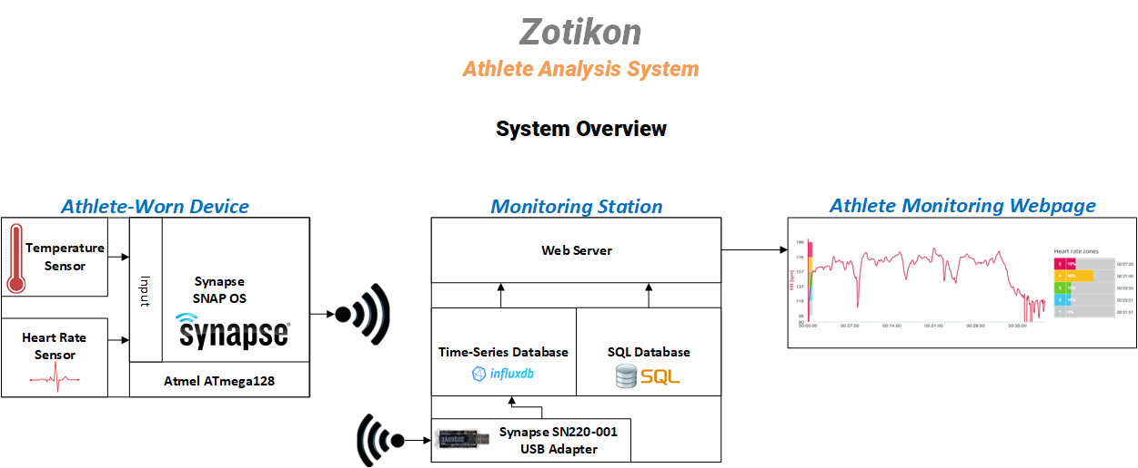
System Overview

Slide 8
Design Constraints Technical
Name | Description
Transmission Range | The Zotikon system must be able to reliably transmit data to at least 70 meters in a noisy environment with radio interference with a success rate of at least 90 percent.
Max Beats per Minute (BPM) | The maximum beats per minute the athlete-worn device must be able to measure is 220 BPM.
Simultaneous Users | The monitoring station must be able to receive data from 11 athlete-worn devices simultaneously.
Runtime | The athlete-worn device must be able to operate continuously for no less than 4 hours.
Skin Temperature Measurable Range | The athlete-worn device must be able to measure temperatures in the range of 15℃ - 47℃ with 0.25℃ accuracy.

Slide 9
Design Constraints Practical
Type | Name | Description
Economic | Cost | Total System Cost: $3,000 Athlete-Worn Device: $150 Monitoring Station: $1,500
Environmental | Physical | IP64 Compliant Temperature Range: -40℃ to 85℃

Slide 10
Approach Hardware Heart Rate System
Input
Two Electrodes
Amplification
Instrumentation Amplifier
Filtering
First-order low-pass (f < 5Hz) RC filter
Sampling
Analog-to-Digital Converter at 60Hz

Slide 11
Approach Hardware Heart Rate System
Component (IA) | Voltage Rail Style | Supply Voltage (V) | Supply Current (µ) | Gain (V/V) | Gain Error (%) | Cost (USD)
Texas Instruments INA126PA | Single or Dual | 2.7 - 36 | 175 | 10000 | 0.1 | 3.15
Analog Devices AD623ANZ | Single or Dual | 2.7 - 12 | 375 | 1000 | 0.35 | 6.31
Texas Instruments INA122P | Single or Dual | 2.2 - 36 | 60 | 10000 | 0.1 | 7.65

Slide 12
Approach Hardware Heart Rate System
Component (ADC) | Communication Interface | Max Single-Ended Reference Voltage | Supply Voltage (V) | Resolution (bits) | Cost (USD)
Synapse SM200 | On-Chip | 1.8V | 3.3V | 10 | 30.07
Microchip MCP3002 | SPI | 2.7 – 5.5 | 2.7 – 5.5 | 10 | 2.30

Slide 13
Approach Hardware Temperature System
Component (Thermometer) | Price (USD) | Communication Interface | Sensor Type | Degree Accuracy (℃) | Measurement Resolution (℃) | Max V_{DD} (V)
Melexis MLX90615 | 13.09 | SMBus or PWM | IR | 0.5 | 0.02 | 3.4
TI TMP20AIDCKR | 1.29 | Analog Voltage | Contact | 2.5 | 0.05 | 5.5
Microchip MCP9808T-E/MS | 1.19 | I2C or SMBus | Contact | 0.5 | 0.05 | 5.5

Slide 14
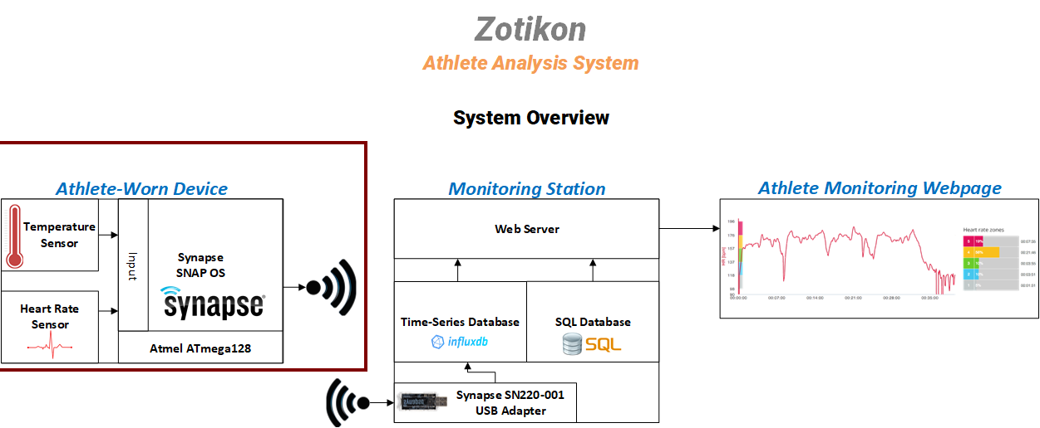

Slide 15
Approach Hardware Radio
Component (Radio) | Current Draw (mA) | Range (m) | Network Protocol | Cost (USD) | Bandwidth (Kbps) | Noise (dBm) | Encryption
Synapse SM200 | 22.5 | 457 - 762 | SNAP (mesh) | 30.07 | 250 - 2000 | -100 | AES 128-bit
Atmel ATmega128RFA1 | 12.5 | 457 – 762 | IEEE 802.15.4 | 6.63 | 250 – 2000 | -100 | AES 128-bit
Time Domain PulsON330 | 440 | 240 - 1000 | ALOHA or TDMA | --- | 19.2 – 612 | -113 to -98 | Not Implemented
Decawave DW1000 | 70 | 100 | Not Implemented | 15.19 | 110 - 6800 | -106 to -94 | Not Implemented

Slide 16
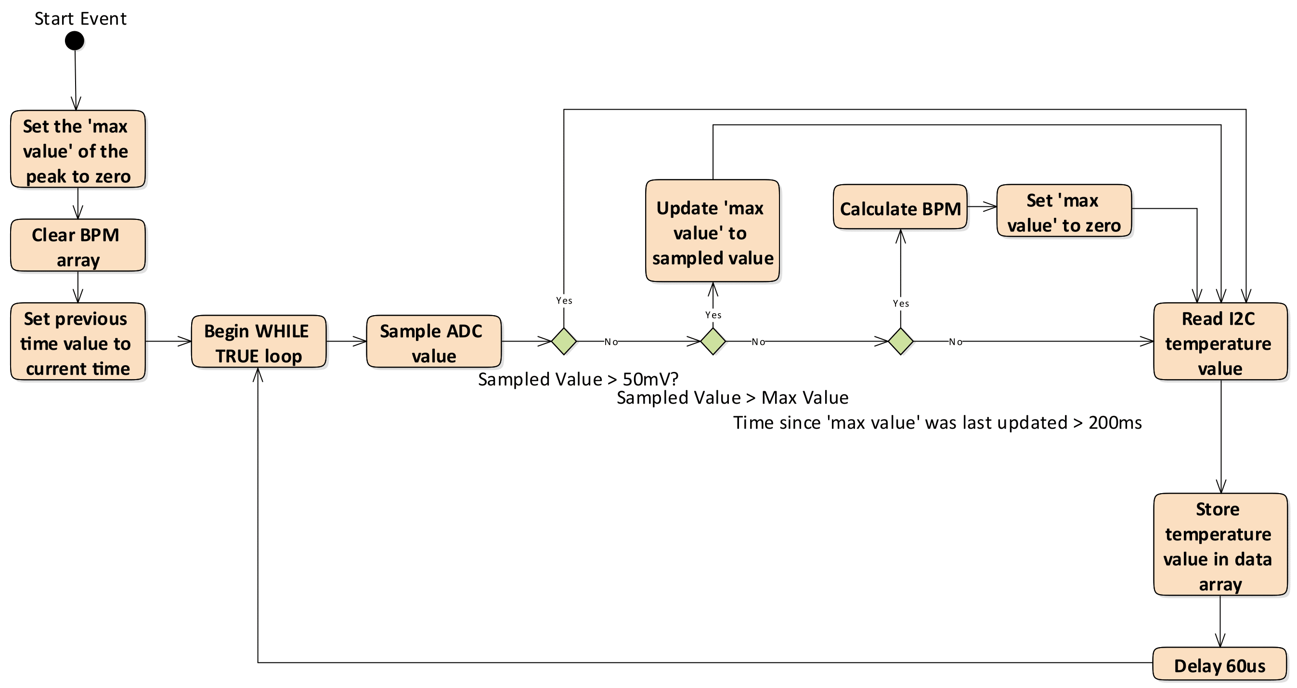
Athlete-Worn Device – Measurement Collection Flow Diagram

Slide 17
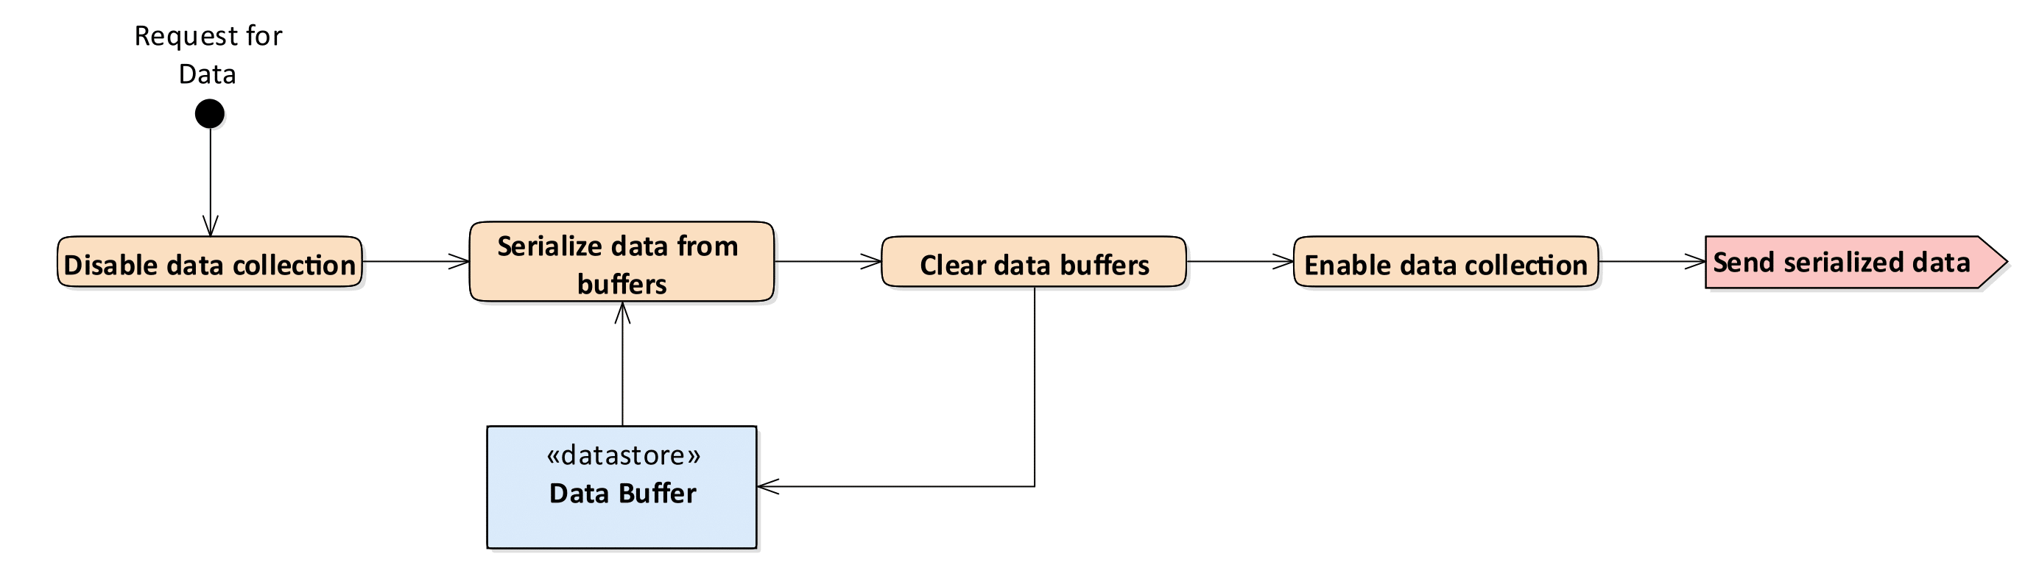
Athlete-Worn Device – Data Transmission Flow Diagram

Slide 18
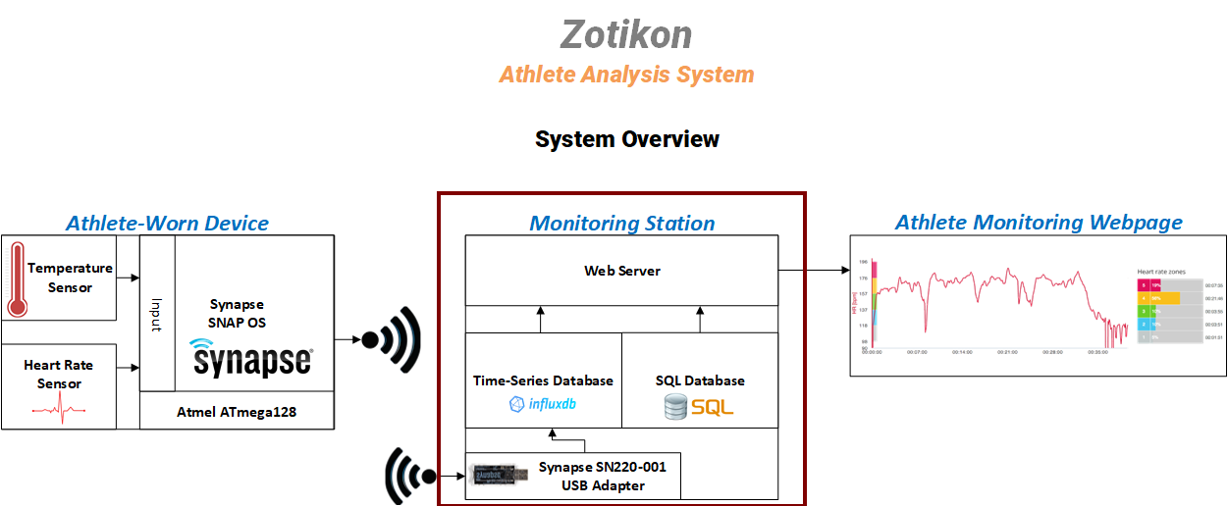

Slide 19
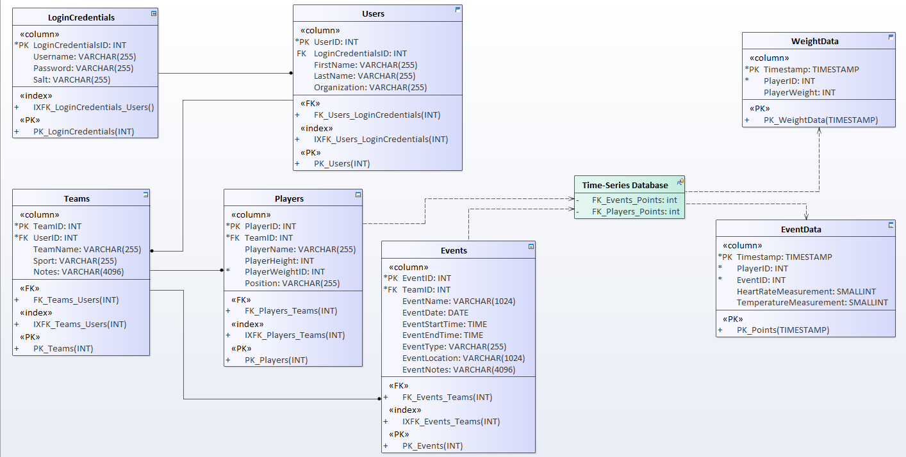
Monitoring Station – Database Design

Slide 20
Progress
Test Number | Parameters | Signal Strength (%) | Ping Successful | Data Sent
1 | Device A facing monitoring station | 35 | Good | Good
2 | Device A facing basketball goal | 28 | Good | Good
3 | Device A facing monitoring station on opposite side in the middle of the court. Device B facing the basketball goal | 41 | Good | Good

Slide 21
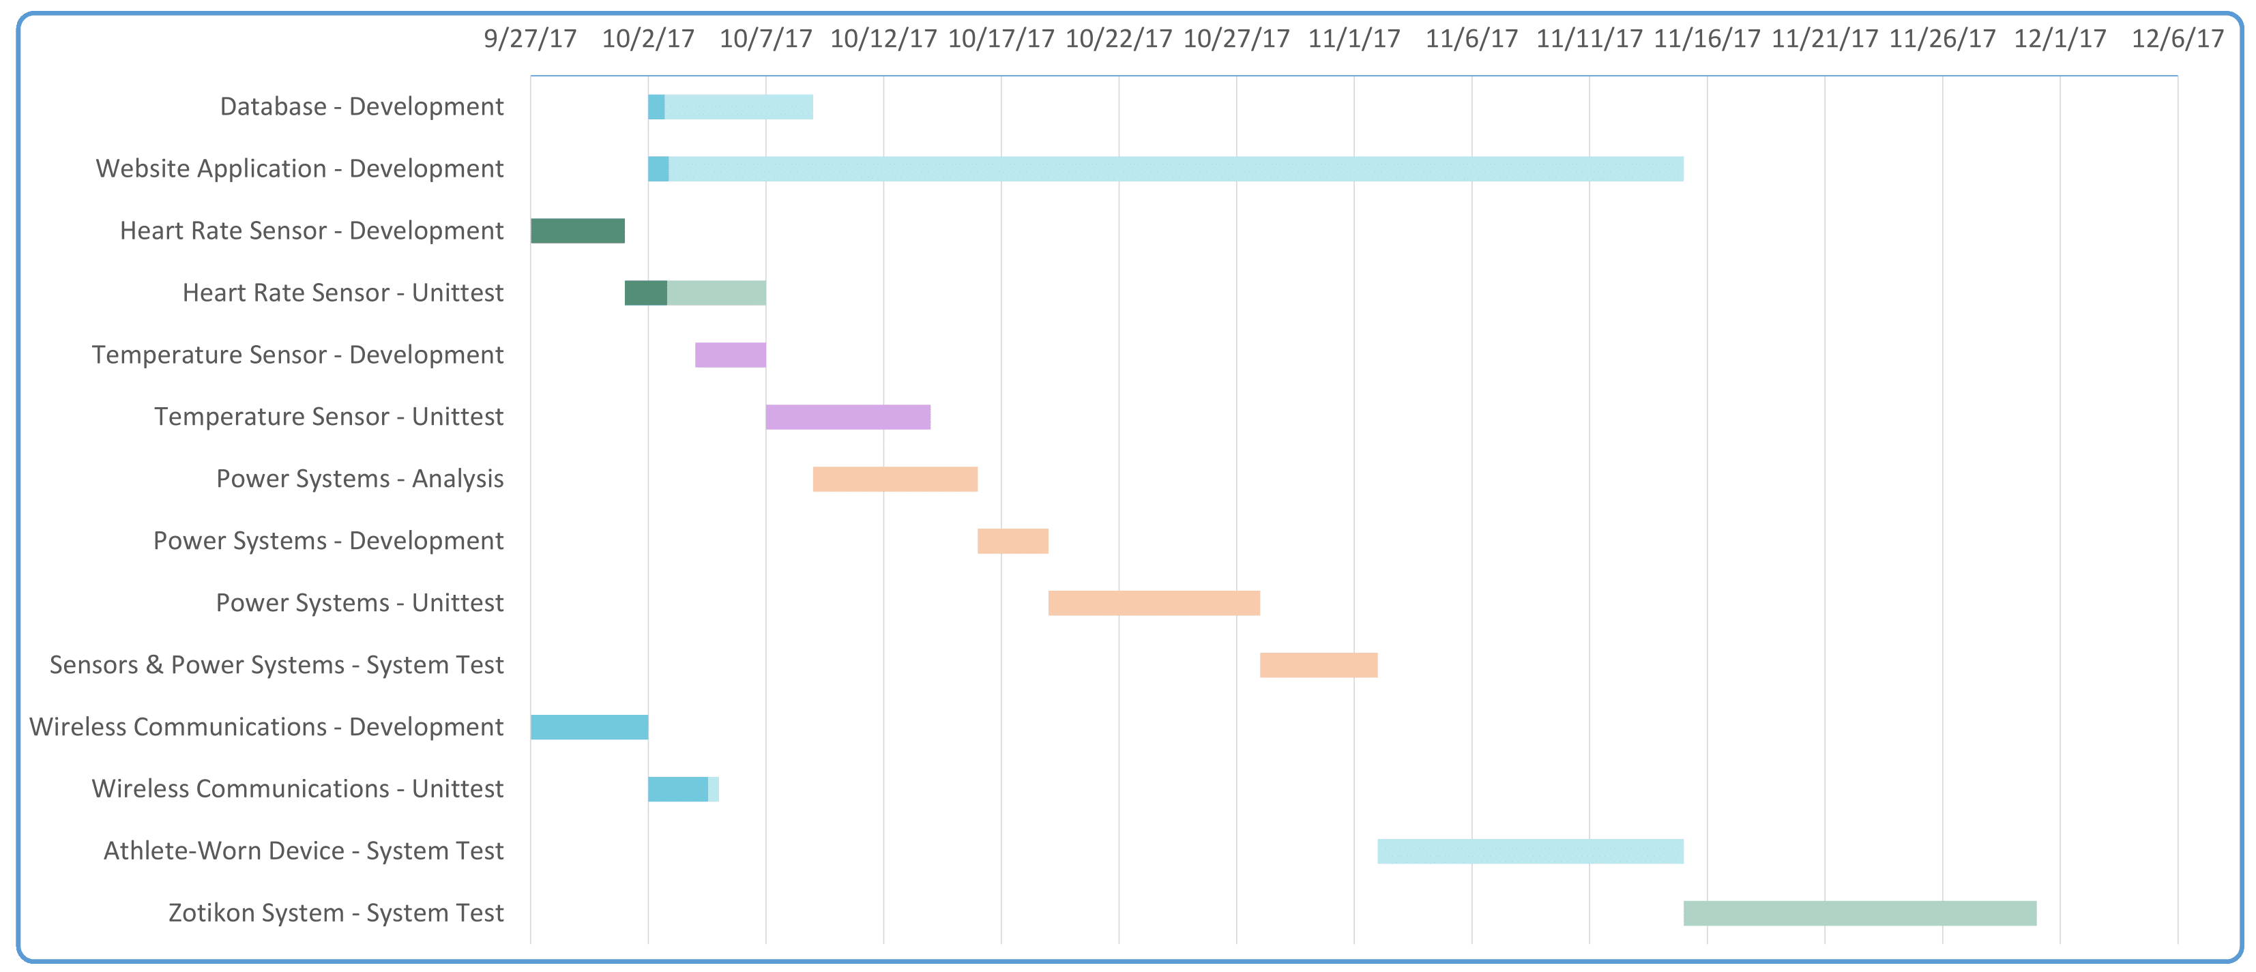
Project Timeline

